Slide 1
시소러스 보충
순천향대학교
컴퓨터시스템연구실
이인규
22.11.10

Slide 2
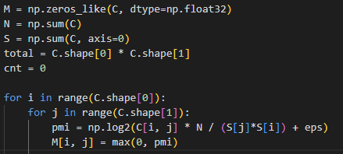

통계 기반 기법 과정
3. 양의 점별 상호정보량 PPMI
-> Positive Pointwise Mutual Information
$$PMI\left(x,y\right)=\log_{2}{(\frac{P\left(x,y\right)}{P\left(x\right)P\left(y\right)}+eps)}$$
$$PPMI\left(x,y\right)=max⁡( PMI\left(x,y\right), 0 )$$
 | you | say | goodbye | and | i | hello | .
you | 0 | 1 | 0 | 0 | 0 | 0 | 0
say | 1 | 0 | 1 | 0 | 1 | 1 | 0
goodbye | 0 | 1 | 0 | 1 | 0 | 0 | 0
and | 0 | 0 | 1 | 0 | 1 | 0 | 0
i | 0 | 1 | 0 | 1 | 0 | 0 | 0
hello | 0 | 1 | 0 | 0 | 0 | 0 | 1
. | 0 | 0 | 0 | 0 | 0 | 1 | 0

Slide 3
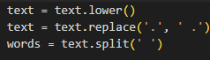
통계 기반 기법 과정
You say goodbye and I say hello.
1. 단어마다 split

Slide 4
통계 기반 기법 과정
You say goodbye and I say hello.
2. window size 결정, 동시 발생 행렬 생성
-> numpy 배열 사용
 | you | say | goodbye | and | i | hello | .
you | 0 | 1 | 0 | 0 | 0 | 0 | 0
say | 1 | 0 | 1 | 0 | 1 | 1 | 0
goodbye | 0 | 1 | 0 | 1 | 0 | 0 | 0
and | 0 | 0 | 1 | 0 | 1 | 0 | 0
i | 0 | 1 | 0 | 1 | 0 | 0 | 0
hello | 0 | 1 | 0 | 0 | 0 | 0 | 1
. | 0 | 0 | 0 | 0 | 0 | 1 | 0

Slide 5
통계 기반 기법 과정
3. 양의 점별 상호정보량 PPMI
-> Positive Pointwise Mutual Information
$$PMI\left(x,y\right)=\log_{2}{(\frac{P\left(x,y\right)}{P\left(x\right)P\left(y\right)}+eps)}$$
$$PPMI\left(x,y\right)=max⁡( PMI\left(x,y\right), 0 )$$
 | you | say | goodbye | and | i | hello | .
you | 0 | 1 | 0 | 0 | 0 | 0 | 0
say | 1 | 0 | 1 | 0 | 1 | 1 | 0
goodbye | 0 | 1 | 0 | 1 | 0 | 0 | 0
and | 0 | 0 | 1 | 0 | 1 | 0 | 0
i | 0 | 1 | 0 | 1 | 0 | 0 | 0
hello | 0 | 1 | 0 | 0 | 0 | 0 | 1
. | 0 | 0 | 0 | 0 | 0 | 1 | 0

Slide 6
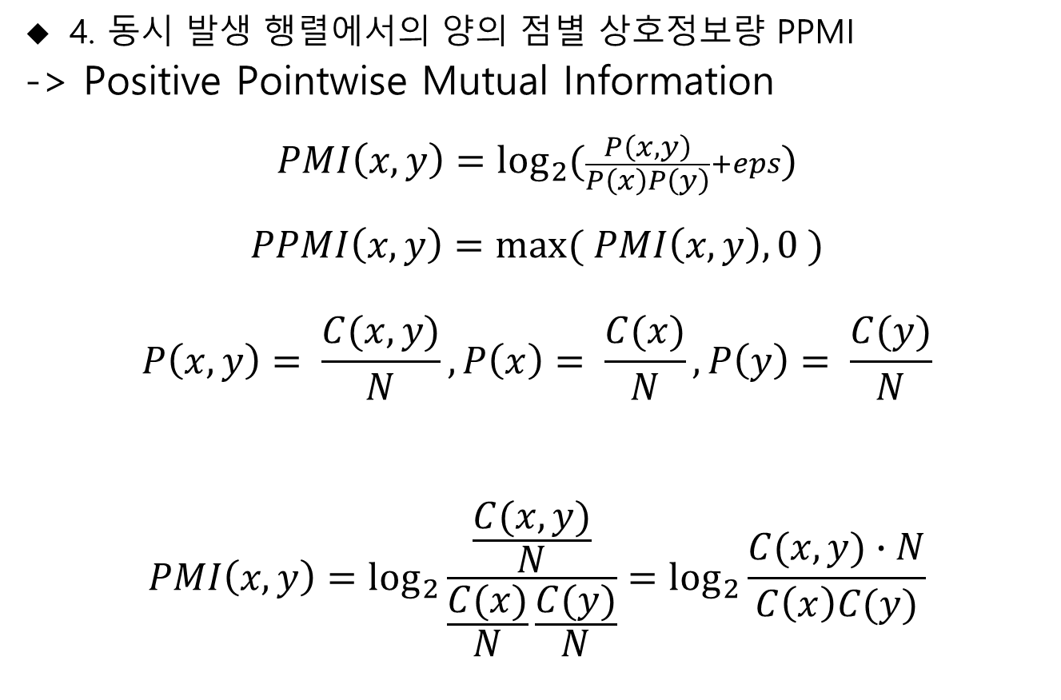
통계 기반 기법 과정
4. 동시 발생 행렬에서의 양의 점별 상호정보량 PPMI
-> Positive Pointwise Mutual Information
$$PMI\left(x,y\right)=\log_{2}{(\frac{P\left(x,y\right)}{P\left(x\right)P\left(y\right)}+eps)}$$
$$PPMI\left(x,y\right)=max⁡( PMI\left(x,y\right), 0 )$$
$$P\left(x,y\right)= \frac{C(x,y)}{N}, P\left(x\right)= \frac{C(x)}{N}, P\left(y\right)= \frac{C(y)}{N}$$
$$PMI\left(x,y\right)=\log_{2}{\frac{\frac{C(x,y)}{N}}{\frac{C(x)}{N}\frac{C(y)}{N}}=\log_{2}{\frac{C(x,y)∙N}{C\left(x\right)C(y)}}}$$

Slide 7


통계 기반 기법 과정
5. PPMI 계산 후 유사도 출력 x=goodbye, y=say
 | you | say | goodbye | And | i | hello | .
you | 0 | 1 | 0 | 0 | 0 | 0 | 0
say | 1 | 0 | 1 | 0 | 1 | 1 | 0
goodbye | 0 | 1 | 0 | 1 | 0 | 0 | 0
and | 0 | 0 | 1 | 0 | 1 | 0 | 0
i | 0 | 1 | 0 | 1 | 0 | 0 | 0
hello | 0 | 1 | 0 | 0 | 0 | 0 | 1
. | 0 | 0 | 0 | 0 | 0 | 1 | 0
$$\log_{2}{\frac{C(x,y)∙N}{C\left(x\right)C(y)}}=\log_{2}{\frac{1∙14}{2∙4}}=0.807354$$

Slide 8
통계 기반 기법 과정
6. PPMI 계산 후 유사도 출력
 | you | say | goodbye | and | i | hello | .
you | 0 | 1.807 | 0 | 0 | 0 | 0 | 0
say | 1.807 | 0 | 0.807 | 0 | 0.807 | 0.807 | 0
goodbye | 0 | 0.807 | 0 | 1.807 | 0 | 0 | 0
and | 0 | 0 | 1.807 | 0 | 1.807 | 0 | 0
i | 0 | 0.807 | 0 | 1.807 | 0 | 0 | 0
hello | 0 | 0.807 | 0 | 0 | 0 | 0 | 2.807
. | 0 | 0 | 0 | 0 | 0 | 2.807 | 0

